Slide 1
ECON2026 Money and Banking
Lecture Slides 5

Slide 2
Part I: Central Banks

Slide 3
Learning Objectives
Factors motivate Central Banks
Central Bank independence

Slide 4
How a Central Bank Operates? Factors That Motivate a Central Bank
Public interest view is a theory of central bank decision making that holds that officials act in the best interest of the public.
A Central Bank seeks to achieve economic goals that are in the public interest (e.g., price stability, high employment and economic growth).

Slide 5
How a Central Bank Operates? Factors That Motivate a Central Bank
Principal–agent view is a theory of central bank decision making that holds that officials maximize their personal well-being rather than that of the general public.
This view predicts that a Central Bank acts to increase its power, influence, and prestige as an organization, subject to constraints placed by principals (governments).
The principal–agent view also suggests that a Central Bank would fight to maintain its autonomy.
According to the principal–agent view, a Central Bank could manage monetary policy to assist the reelection efforts of incumbent governments who are unlikely to limit its power.

Slide 6
How a Central Bank Operates? Factors That Motivate a Central Bank
The result would be a political business cycle: a Central Bank would try to lower interest rates to stimulate economic activity before an election to earn favor with the incumbent party running for reelection.
The facts for the United States don’t support the political business cycle theory, but the president’s desires may subtly influence Fed policy.

Slide 7
How a Central Bank Operates? Arguments for Central Bank Independence
The main argument for Central Bank independence is that monetary policy is too important and technical to be determined by politicians.
Because of the frequency of elections, politicians may be shortsighted, concerned with short-term benefits without regard for potential long-term costs.
The public may well prefer that the experts at the Central Bank, rather than politicians, make monetary policy decisions.
Another argument for Central Bank independence is that complete control of a Central Bank by elected officials increases the influence of political business cycles on the money supply.

Slide 8
How a Central Bank Operates? Arguments against Central Bank Independence
The importance of monetary policy for the economy is also the main argument against central bank independence.
In a democracy, elected officials should make public policy. The public could hold elected officials responsible for perceived monetary policy problems.
If the central bank was controlled by elected officials, monetary policy could be coordinated and integrated with government taxing and spending policies.

Slide 9
How a Central Bank Operates? Central Bank Independence
There is no universal agreement on the merits of Central Bank independence.
Debates focus on limiting Central Bank independence, not eliminating its formal independence entirely.

Slide 10
Central Bank Independence
The degree of central bank independence varies greatly from country to country.
The European Central Bank, the Fed, and the RBA are extremely independent. The Bank of Japan and the Bank of England traditionally have been less independent.
An independent central bank is free to pursue its goals without direct interference from government officials and legislators.
An independent central bank can more freely focus on keeping inflation low.
The push for central bank independence to pursue a goal of low inflation has increased in recent years.
In most of the industrialized world, central bank independence from the political process is gaining ground as the way to organize monetary authorities.

Slide 11
Central Bank Independence
What conclusions should we draw from differences in central bank structure?
Many analysts believe that an independent central bank improves the economy’s performance by lowering inflation without raising output or employment fluctuations.
The most independent central banks had the lowest average rates of inflation during the 1970s and 1980s.
The central bank also must be able to set goals for which it can be held accountable. The leading example of such a goal is a target for inflation.
Central banks in Australia, Canada, Finland, New Zealand, Sweden, and the United Kingdom have official inflation targets, as does the European Central Bank.
The U.S. Fed has only an informal inflation target.

Slide 12
Part II: The Money Supply Process

Slide 13
Learning Objectives
Explain the relationship between a Central Bank’s balance sheet and the monetary base.
Derive the equation for the simple deposit multiplier and understand what it means.
Explain how the behavior of banks and the nonbank public affect the money multiplier.
Describe the money supply process for M2.

Slide 14
A Central Bank’s Balance Sheet and the Monetary Base
The model of how the money supply is determined includes three actors:
The Central Bank: responsible for controlling the money supply and regulating the banking system.
The banking system: creates the checking accounts that are a major component of M1.
The nonbank public (all households and firms): decides the form in which they wish to hold money (e.g., currency vs. checking deposits).

Slide 15
The Central Bank (CB)’s Balance Sheet and the Monetary Base The Money Supply Process
The process starts with the monetary base.
Monetary base (or high-powered money) is the sum of bank reserves and currency in circulation.
The money multiplier links the monetary base to the money supply.
When the money multiplier is stable, the CB can control the money supply by controlling the monetary base.
There is a close connection between the monetary base and the CB’s balance sheet.

Slide 16
The CB’s Balance Sheet and the Monetary Base The Money Supply Process
CB
Assets | Liabilities
Securities | Currency in circulation
Loans to Financial Institutions | Reserves
Liabilities
Currency in circulation: in the hands of the public
Reserves: bank deposits at the CB and vault cash
Assets
Government securities: holdings by the CB that affect money supply and earn interest
Discount loans: provide reserves to banks and earn the discount rate
16

Slide 17
The CB’s Balance Sheet and the Monetary Base The Monetary Base
Currency in circulation is paper money and coins held by the nonbank public.
Vault cash is currency held by banks.
Currency in circulation = Currency outstanding - Vault cash.
Bank reserves = Bank deposits with the CB + Vault cash.
Reserve deposits are assets for banks and liabilities for the CB. Why?
Banks can request that the CB repay the deposits on demand.
17

Slide 18
The CB’s Balance Sheet and the Monetary Base The Monetary Base
Reserves = Required reserves + Excess reserves.
Required reserves are reserves that the CB requires banks to hold.
Excess reserves are reserves that banks hold above those the CB requires to hold.
Required reserve ratio is the percentage of checkable deposits that the CB specifies that banks must hold as reserves.
18

Slide 19
The CB’s Balance Sheet and the Monetary Base How the CB Changes the Monetary Base
The CB changes the monetary base by changing the levels of its assets— through buying and selling Treasury securities or making discount loans to banks.
Open market operations are the CB’s purchases and sales of securities, usually Treasury securities, in financial markets.
Open market purchase is the CB’s purchase of securities.
Open market sale is the CB’s sale of securities.
19

Slide 20


The CB’s Balance Sheet and the Monetary Base How the CB Changes the Monetary Base
Example: Open market purchase—the Fed (the US Central Bank) buys $1 million worth of Treasury bills from the PNC bank.
T-account for the whole banking system and the Fed:
Result: The monetary base increases by the dollar amount of an open market purchase.
20

Slide 21


The CB’s Balance Sheet and the Monetary Base How the CB Changes the Monetary Base
Example: Open market sale—the Fed sells $1 million worth of Treasury bills to the Bank of America.
T-account for the whole banking system and the Fed:
Result: The monetary base decreases by the dollar amount of an open market sale.
21

Slide 22


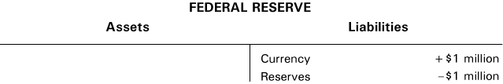
The CB’s Balance Sheet and the Monetary Base How the CB Changes the Monetary Base
The public’s preference for currency relative to checkable deposits does not affect the monetary base.
Example: Households and firms decide withdraw $1 million from their checking accounts.
One component of the monetary base (reserves) has fallen while the other (currency in circulation) has risen.
22

Slide 23


The CB’s Balance Sheet and the Monetary Base Discount Loans
Discount loan is a loan made by a CB to a commercial bank.
Discount loans alter bank reserves.
An increase in discount loans affects both sides of the CB’s balance sheet:
For instance, $1 million of discount loans made by the Fed increases bank reserves and the monetary base by $1 million
23

Slide 24


The CB’s Balance Sheet and the Monetary Base Discount Loans
If banks repay $1 million in discount loans to the Fed, the preceding transactions are reversed.
24

Slide 25
The CB’s Balance Sheet and the Monetary Base Open Market Operations vs. Discount Loans
Both open market operations and discount loans change the monetary base, but the CB has greater control over open market operations.
Discount rate is the interest rate the CB charges on discount loans.
The discount rate differs from most interest rates because it is set by the CB, whereas most interest rates are determined by demand and supply in financial markets.
The monetary base (B) includes: the non-borrowed monetary base (B_{non}) and borrowed reserves (BR) (same as discount loans).
The CB has control over the non-borrowed monetary base.
25

Slide 26
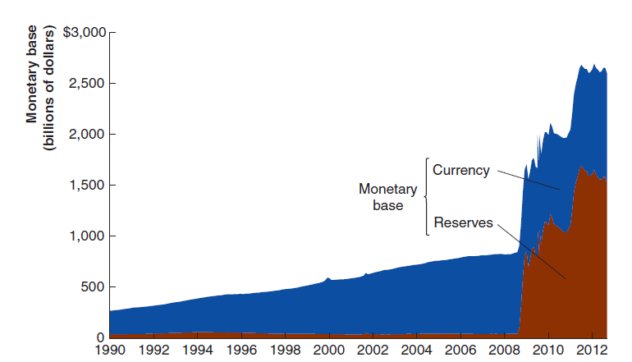
The Fed’s Balance Sheet and the Monetary Base Explaining the Explosion in the Monetary Base
The monetary base increased sharply in the fall of 2008.
Most of the increase occurred because of an increase in the bank reserves component.
Holdings of Treasury securities actually fell while the base was exploding.
As the Fed began to purchase assets connected with Bear Stearns and AIG, the asset side of its balance sheet expanded, and so did the monetary base. This is called as Quantitative Easing (buying private assets)!
Key point: Whenever the Fed purchases assets of any kind, the monetary base increases.
https://www.federalreserve.gov/releases/h6/current/default.htm
Monetary Base; Total (BOGMBASE) | FRED | St. Louis Fed (stlouisfed.org)
26

Slide 27
The CB’s Balance Sheet and the Monetary Base The Simple Deposit Multiplier
The money multiplier helps us understand the factors that determine the money supply.
The money multiplier is determined by the actions of three actors in the economy: the CB, the nonbank public, and banks.
27

Slide 28

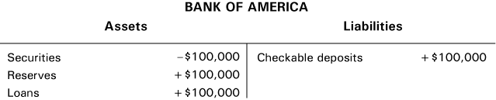
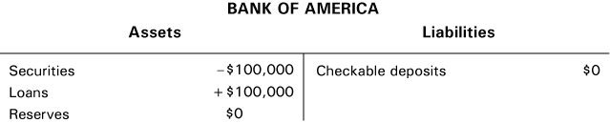
The CB’s Balance Sheet and the Monetary Base Multiple Deposit Expansion How a Single Bank Responds to an Increase in Reserves
The Fed purchases $100,000 in Treasury bills from Bank of America:
Next, Bank of America extends a loan to Rosie’s Bakery:
Rosie’s spends the loan proceeds by writing a check for $100,000 to buy ovens from Bob’s Bakery Equipment, so Bank of America loses $100,000 checkable deposits:
28

Slide 29

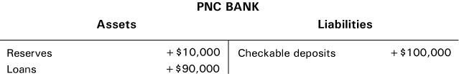

The CB’s Balance Sheet and the Monetary Base Multiple Deposit Expansion How the Banking System Responds to an Increase in Reserves
Suppose Bob’s deposits the check in its account with PNC Bank. After PNC has cleared the check and collected the funds from Bank of America:
Suppose that PNC makes a $90,000 loan to Jerome’s Printing who writes a check in that amount for equipment from Computer Universe who has an account at SunTrust Bank:
29

Slide 30
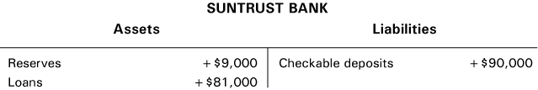
The CB’s Balance Sheet and the Monetary Base Multiple Deposit Expansion How the Banking System Responds to an Increase in Reserves
Suppose that SunTrust lends its new excess reserves of $81,000 to Howard’s Barber Shop to use for remodeling:
If the proceeds of the loan to Howard’s Barber Shop are deposited in another bank, checkable deposits in the banking system will rise by another $81,000.
So far, the level of checkable deposits has increased by $100,000 + $90,000 + $81,000 = $271,000. This process is called multiple deposit creation.
Multiple deposit creation is part of the money supply process in which an increase in bank reserves results in rounds of bank loans and creation of checkable deposits.
As a result, an increase in the money supply is a multiple of the initial increase in reserves.
30

Slide 31
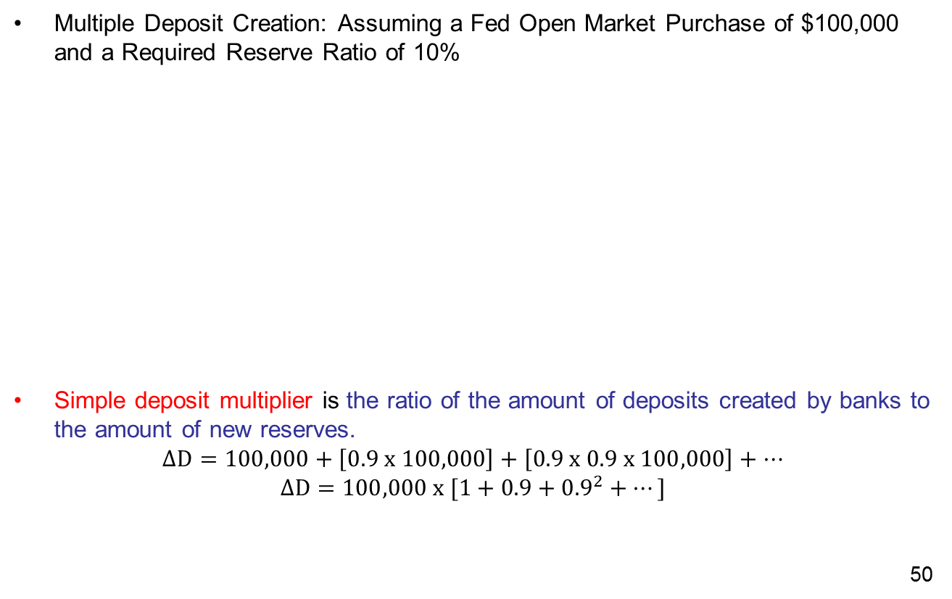
The CB’s Balance Sheet and the Monetary Base Calculating the Simple Deposit Multiplier
Multiple Deposit Creation: Assuming a Fed Open Market Purchase of $100,000 and a Required Reserve Ratio of 10%
Simple deposit multiplier is the ratio of the amount of deposits created by banks to the amount of new reserves.
$$∆D=100,000+\left[0.9 x 100,000\right]+\left[0.9 x 0.9 x 100,000\right]+…$$
$$∆D=100,000 x [1+0.9+{0.9}^{2}+…]$$
31
Bank | Increase in deposits | Increase in loans | Increase in reserves
PNC Bank | $100,000 | $90,000 | $10,000
Sun Trust Bank | 90,000 | 81,000 | 9,000
Third Bank | 81,000 | 72,900 | 8,100
Fourth Bank | 72,900 | 65,610 | 7,290
Fifth Bank | 65,610 | 59,049 | 6,561
. | . | . | .
Total Increase | 1,000,000 | 900,000 | 100,000

Slide 32
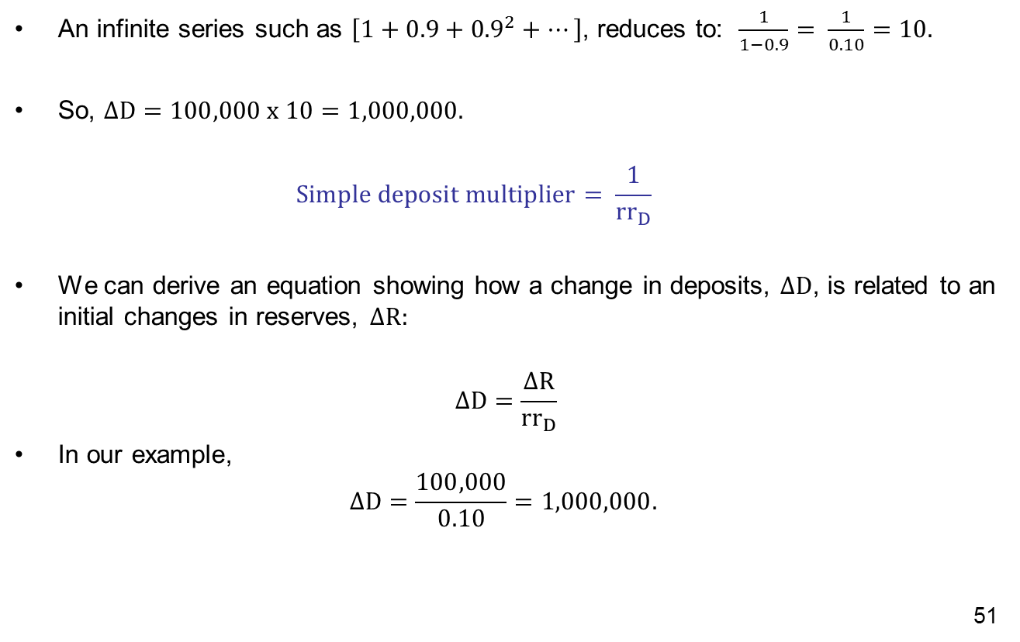
The CB’s Balance Sheet and the Monetary Base Calculating the Simple Deposit Multiplier
An infinite series such as $\left[1+0.9+{0.9}^{2}+…\right]$, reduces to: $\frac{1}{1−0.9}= \frac{1}{0.10}=10.$
So, $∆D=100,000 x 10=1,000,000.$
$$Simple deposit multiplier= \frac{1}{{rr}_{D}}$$
We can derive an equation showing how a change in deposits, $∆D$, is related to an initial changes in reserves, $∆R:$
$$∆D=\frac{∆R}{{rr}_{D}}$$
In our example,
$$∆D=\frac{100,000}{0.10}=1,000,000.$$
32

Slide 33
Banks, the Nonbank Public, and the Money Multiplier Increases in Currency Holdings and Increases in Excess Reserves
Key assumptions for deriving the deposit multiplier:
Banks hold no excess reserves.
The nonbank public does not increase its holdings of currency.
In order to build a complete account of the money supply process, we change the simple deposit multiplier in three ways:
Rather than a link between reserves and deposits, we need a link between the monetary base and the money supply.
We need to include the effects of changes in the nonbank public’s desire to hold currency relative to checkable deposits.
We need to include the effects of changes in banks’ desire to hold excess reserves.
33

Slide 34
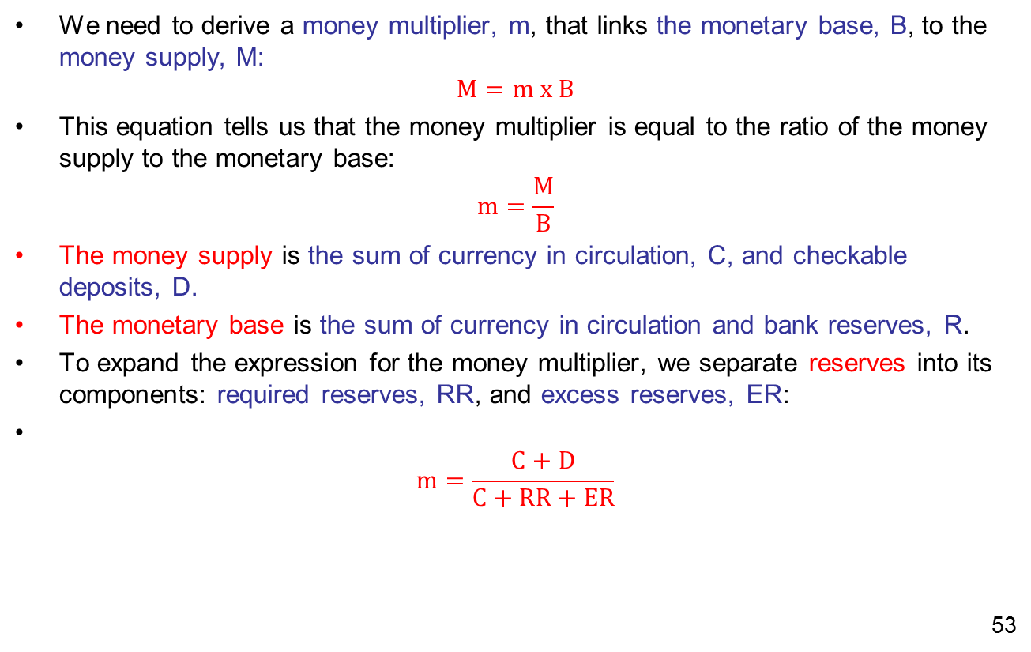
Banks, the Nonbank Public, and the Money Multiplier Deriving a Realistic Money Multiplier
We need to derive a money multiplier, m, that links the monetary base, B, to the money supply, M:
$$M=m x B$$
This equation tells us that the money multiplier is equal to the ratio of the money supply to the monetary base:
$$m=\frac{M}{B}$$
The money supply is the sum of currency in circulation, C, and checkable deposits, D.
The monetary base is the sum of currency in circulation and bank reserves, R.
To expand the expression for the money multiplier, we separate reserves into its components: required reserves, RR, and excess reserves, ER:
$$m=\frac{C+D}{C+RR+ER}$$
34

Slide 35
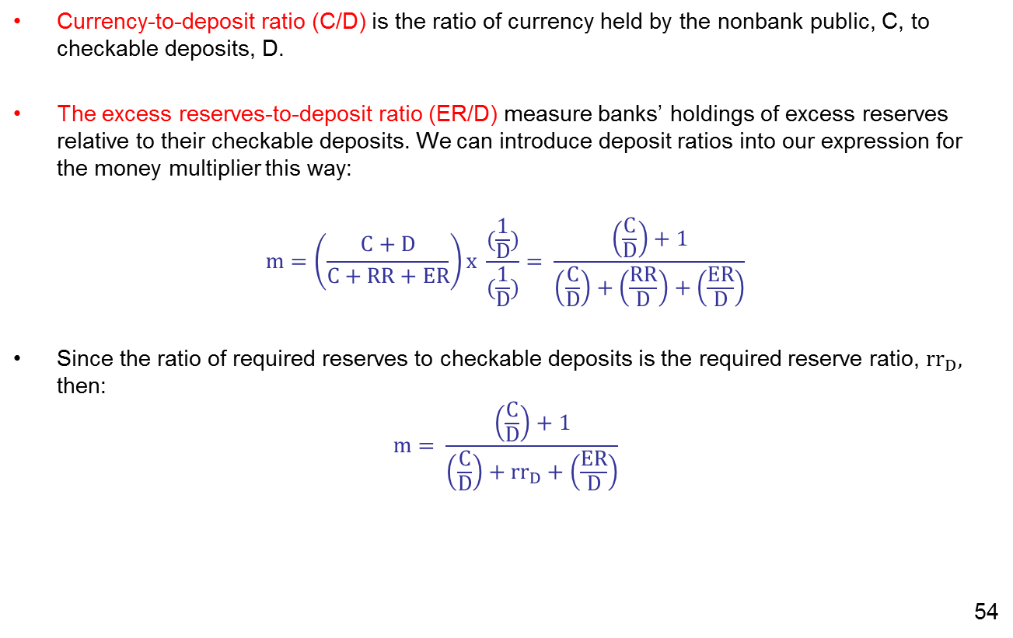
Banks, the Nonbank Public, and the Money Multiplier Deriving a Realistic Money Multiplier
Currency-to-deposit ratio (C/D) is the ratio of currency held by the nonbank public, C, to checkable deposits, D.
The excess reserves-to-deposit ratio (ER/D) measure banks’ holdings of excess reserves relative to their checkable deposits. We can introduce deposit ratios into our expression for the money multiplier this way:
$$m=\left(\frac{C+D}{C+RR+ER}\right)x \frac{(\frac{1}{D})}{(\frac{1}{D})}= \frac{\left(\frac{C}{D}\right)+1}{\left(\frac{C}{D}\right)+\left(\frac{RR}{D}\right)+\left(\frac{ER}{D}\right)}$$
Since the ratio of required reserves to checkable deposits is the required reserve ratio, ${rr}_{D},$ then:
$$m= \frac{\left(\frac{C}{D}\right)+1}{\left(\frac{C}{D}\right)+{rr}_{D}+\left(\frac{ER}{D}\right)}$$
35

Slide 36
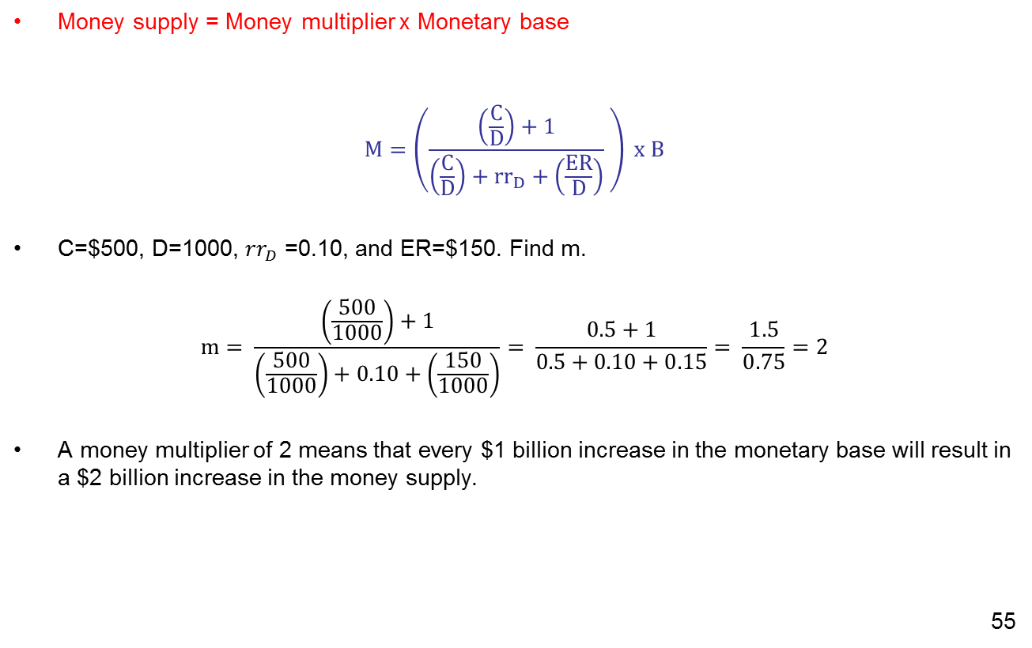
Banks, the Nonbank Public, and the Money Multiplier Deriving a Realistic Money Multiplier
Money supply = Money multiplier x Monetary base
$$M=\left(\frac{\left(\frac{C}{D}\right)+1}{\left(\frac{C}{D}\right)+{rr}_{D}+\left(\frac{ER}{D}\right)} \right) x B$$
C=$500, D=1000, ${rr}_{D}$ =0.10, and ER=$150. Find m.
$$m= \frac{\left(\frac{500}{1000}\right)+1}{\left(\frac{500}{1000}\right)+0.10+\left(\frac{150}{1000}\right)}= \frac{0.5+1}{0.5+0.10+0.15}= \frac{1.5}{0.75}=2$$
A money multiplier of 2 means that every $1 billion increase in the monetary base will result in a $2 billion increase in the money supply.
36

Slide 37
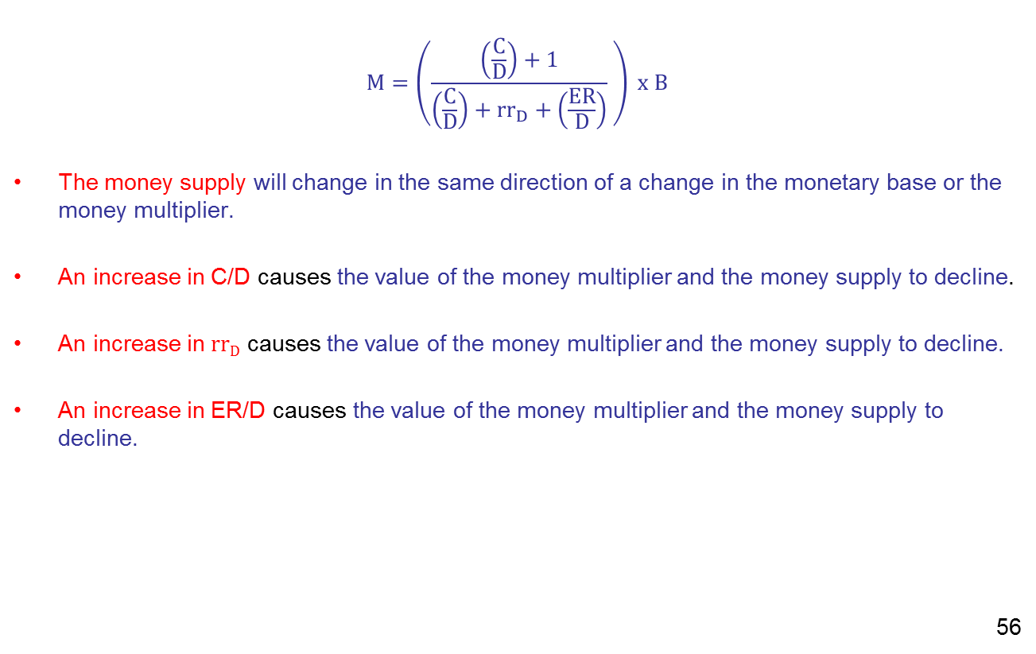
Banks, the Nonbank Public, and the Money Multiplier Deriving a Realistic Money Multiplier
$$M=\left(\frac{\left(\frac{C}{D}\right)+1}{\left(\frac{C}{D}\right)+{rr}_{D}+\left(\frac{ER}{D}\right)} \right) x B$$
The money supply will change in the same direction of a change in the monetary base or the money multiplier.
An increase in C/D causes the value of the money multiplier and the money supply to decline.
An increase in $rrD$ causes the value of the money multiplier and the money supply to decline.
An increase in ER/D causes the value of the money multiplier and the money supply to decline.
37

Slide 38
Banks, the Nonbank Public, and the Money Multiplier Deriving a Realistic Money Multiplier: Example
Bank reserves = $500 billion
Currency = $400 billion
If banks are holding $80 billion in required reserves, and the required reserve ratio = 0.10, what is the value of checkable deposits?
Given this information, what is the value of the money supply (M1)? What is the value of the monetary base? What is the value of the money multiplier?
38

Slide 39
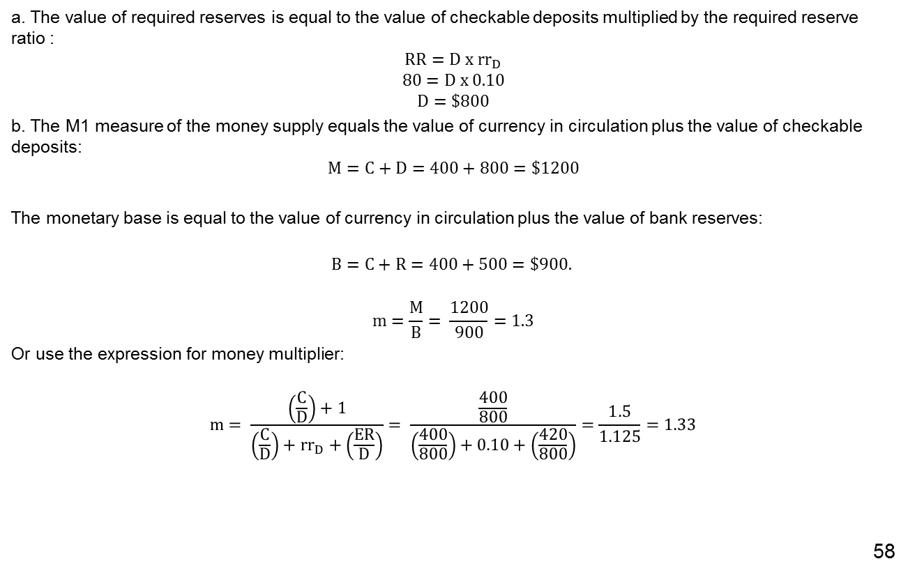
Banks, the Nonbank Public, and the Money Multiplier Deriving a Realistic Money Multiplier: Example
a. The value of required reserves is equal to the value of checkable deposits multiplied by the required reserve ratio :
$$RR=D x {rr}_{D}$$
$$80=D x 0.10$$
$$D=\$800$$
b. The M1 measure of the money supply equals the value of currency in circulation plus the value of checkable deposits:
$$M=C+D=400+800=\$1200$$
The monetary base is equal to the value of currency in circulation plus the value of bank reserves:
$$B=C+R=400+500=\$900.$$
$$m=\frac{M}{B}= \frac{1200}{900}=1.3$$
Or use the expression for money multiplier:
$$m= \frac{\left(\frac{C}{D}\right)+1}{\left(\frac{C}{D}\right)+{rr}_{D}+\left(\frac{ER}{D}\right)}= \frac{\frac{400}{800}}{\left(\frac{400}{800}\right)+0.10+\left(\frac{420}{800}\right)}=\frac{1.5}{1.125}=1.33$$
39

Slide 40

Banks, the Nonbank Public, and the Money Multiplier Deriving a Realistic Money Multiplier
Recall that the monetary base is the sum of borrowed plus non-borrowed reserves:
$$B=B_{non}+BR$$
Rewriting the relationship between the money supply and the monetary base:
$$M=\left(\frac{\left(\frac{C}{D}\right)+1}{\left(\frac{C}{D}\right)+{rr}_{D}+\left(\frac{ER}{D}\right)} \right) x \left(B_{non}+BR \right)$$
We now have a complete description of the money supply process:
An increase in the ... | based on the actions of ... | Causes the money supply to... | because...
non-borrowed base | the CB through open market operations | increase | the monetary base increases, and more reserves are available for deposit expansion
required reserve ratio | the CB through change sin reserve requirements | decrease | fewer reserves can be lent out, and the value of money multiplier falls
currency-to-deposit ratio | the non-bank public | decrease | the value of the money multiplier falls, reducing deposit expansion
excess reserves to deposit ratio | banks | decrease | the value of the money multiplier falls, reducing deposit expansion
40

Slide 41
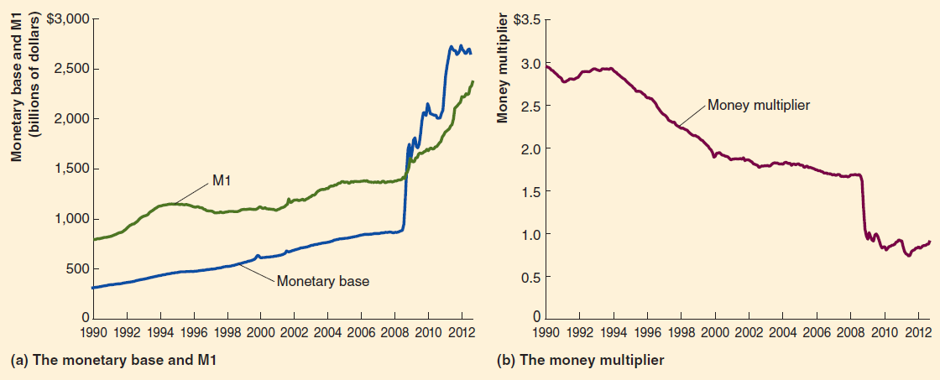
Banks, the Nonbank Public, and the Money Multiplier M, m, and B During 2007-2009 Financial Crisis
Panel (a) shows that beginning in the fall of 2008, the size of the monetary base soared. M1 also increased, but not nearly as much.
Panel (b) shows that the value of the money multiplier declined sharply during the same period.
Monetary Base; Total (BOGMBASE) | FRED | St. Louis Fed (stlouisfed.org)
M1 (M1SL) | FRED | St. Louis Fed (stlouisfed.org)
41

Slide 42
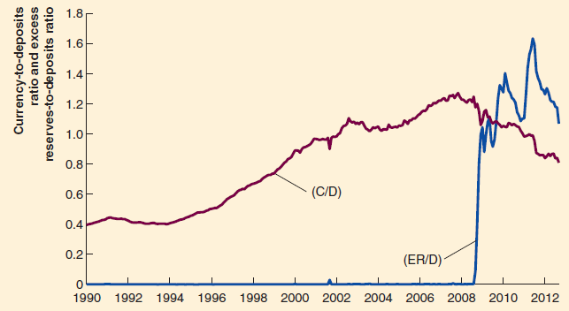
Banks, the Nonbank Public, and the Money Multiplier Why did B increased so much more than M1?
42
The currency-to-deposit ratio (C/D) fell during the financial crisis of 2007–2009, while the excess reserves-to–deposits ratio (ER/D) soared.
42

Slide 43
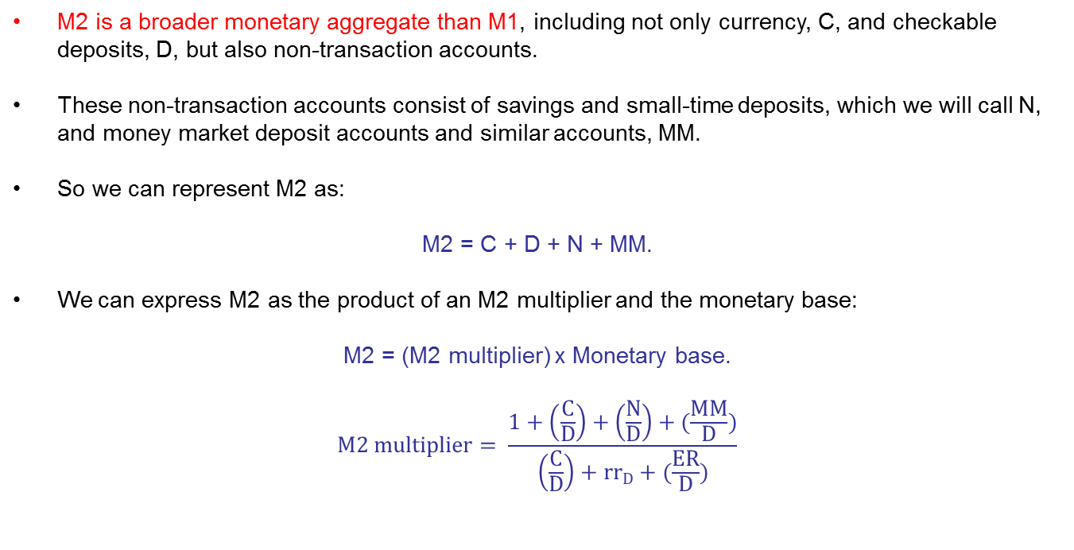
The Money Supply Process for M2
M2 is a broader monetary aggregate than M1, including not only currency, C, and checkable deposits, D, but also non-transaction accounts.
These non-transaction accounts consist of savings and small-time deposits, which we will call N, and money market deposit accounts and similar accounts, MM.
So we can represent M2 as:
M2 = C + D + N + MM.
We can express M2 as the product of an M2 multiplier and the monetary base:
M2 = (M2 multiplier) x Monetary base.
$$M2 multiplier= \frac{1+\left(\frac{C}{D}\right)+\left(\frac{N}{D}\right)+(\frac{MM}{D})}{\left(\frac{C}{D}\right)+{rr}_{D}+(\frac{ER}{D})}$$

Slide 44
What is next?
Next week, we will go over the monetary policies.

